Slide 1

Project Title: Smart Violence Detection with Real-time alerts.
Batch-ID: A-06
Student Team Members:
Full Name: BANDI VENAKTA SIDDHARTH , Roll No: 2451-21-733-007
Full Name : KONDA ANSHU , Roll No: 2451-21-733-011
Full Name: G NIHARIKA , Roll No: 2451-21- 733-019
Guide: M. MADHURI, Assistant Professor, Dept. of CSE, MVSREC

Slide 2
Problem Statement:-Traditional video surveillance systems are inefficient for real-time detection of violent behavior, relying on manual monitoring and struggling to handle large volumes of video data. These systems often miss incidents or trigger false alarms, resulting in delayed responses. There is a need for an automated, scalable solution that accurately detects violence and sends real-time alerts to authorities, ensuring timely interventions and enhanced public safety
Project Scope:-This project aims to develop an automated violence detection system using deep learning and computer vision techniques. The system will analyze video feeds in real-time to identify violent behavior, focusing on motion patterns and body expressions. It will trigger instant alerts to authorities for timely intervention. The project will also allow for future expansions, such as detecting weapons and improving safety for women in public spaces.
Project Objectives:-
•Develop a machine learning-based violence detection model using techniques like action recognition and pattern extraction.
•Achieve high accuracy in detecting violent incidents with minimal false positives.
•Ensure real-time video analysis and alert generation for law enforcement or concerned authorities.
•Extend the system to detect related events such as threats involving weapons and improve public safety measures.
•Build a scalable architecture that allows easy extension for future functionalities.

Slide 3
Application Areas | Challenges
•Public Safety & Surveillance •Law Enforcement •Women’s Safety •Smart City Solutions | Ensuring accurate real-time detection across diverse environments without compromising processing speed or privacy. Ensuring timely and accurate alerts without overwhelming authorities with false positives during chaotic events. Accurately identifying gender-specific threats while minimizing false positives in diverse environments Integrating the system with large-scale urban infrastructure while maintaining real-time accuracy.

Slide 4
Literature Survey
SL | Major Reference(s) | Finding(s)
1 | Crowd Violence Detection Using Global-Motion-Compensated Lagrangian Features and Scale-Sensitive-Video-Level Representation (2017) | Focuses on motion-based violence detection in crowds. Motion-compensated features help track violent behavior, which can be complemented by OpenCV for motion tracking.
2 | Abnormal Event Detection in Crowded Video Scenes (Gnanavel & Arulanandam, 2015) | Discusses feature extraction and anomaly detection, applicable for preprocessing with OpenCV. This can be extended using TensorFlow and LSTM models for detecting temporal events like violence.
3 | Violence Detection in Video Using Spatio-Temporal Features (de Souza et al., 2010) | Combines spatio-temporal features to enhance the detection of violent incidents in videos.
4 | Trajectory-Pooled Deep Convolutional Networks for Violence Detection in Videos (Meng et al., 2017) | Deep CNN models are utilized for detecting violence in videos by analyzing motion trajectories, which can be enhanced with OpenCV and implemented in TensorFlow.
5

Slide 5
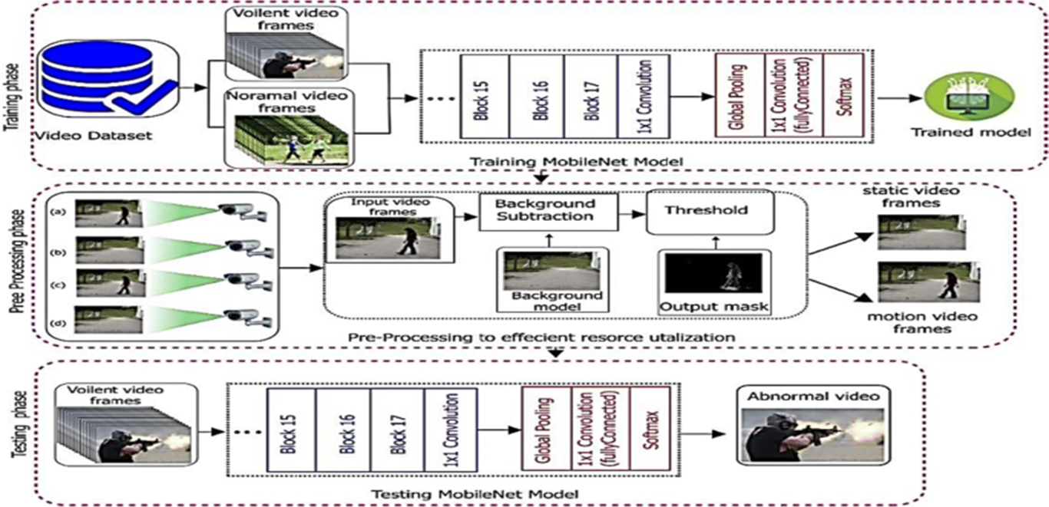
Generic Architecture of the Existing Systems

Slide 6
Software / Hardware requirements for development / deployment
Tool / Technology | Usage
Long Short-Term Memory (LSTM) Networks | For modeling time-based dependencies in video sequences.
3D Convolutional Neural Networks (3D-CNNs) | For action recognition based on spatial and temporal video features.
Kafka | For handling real-time video stream processing and alert dissemination.
Flask | For building the web interface and alerting system for authorities.
OpenCV | For image and video processing tasks.
Python | For developing scripts and deep learning models.

Slide 7
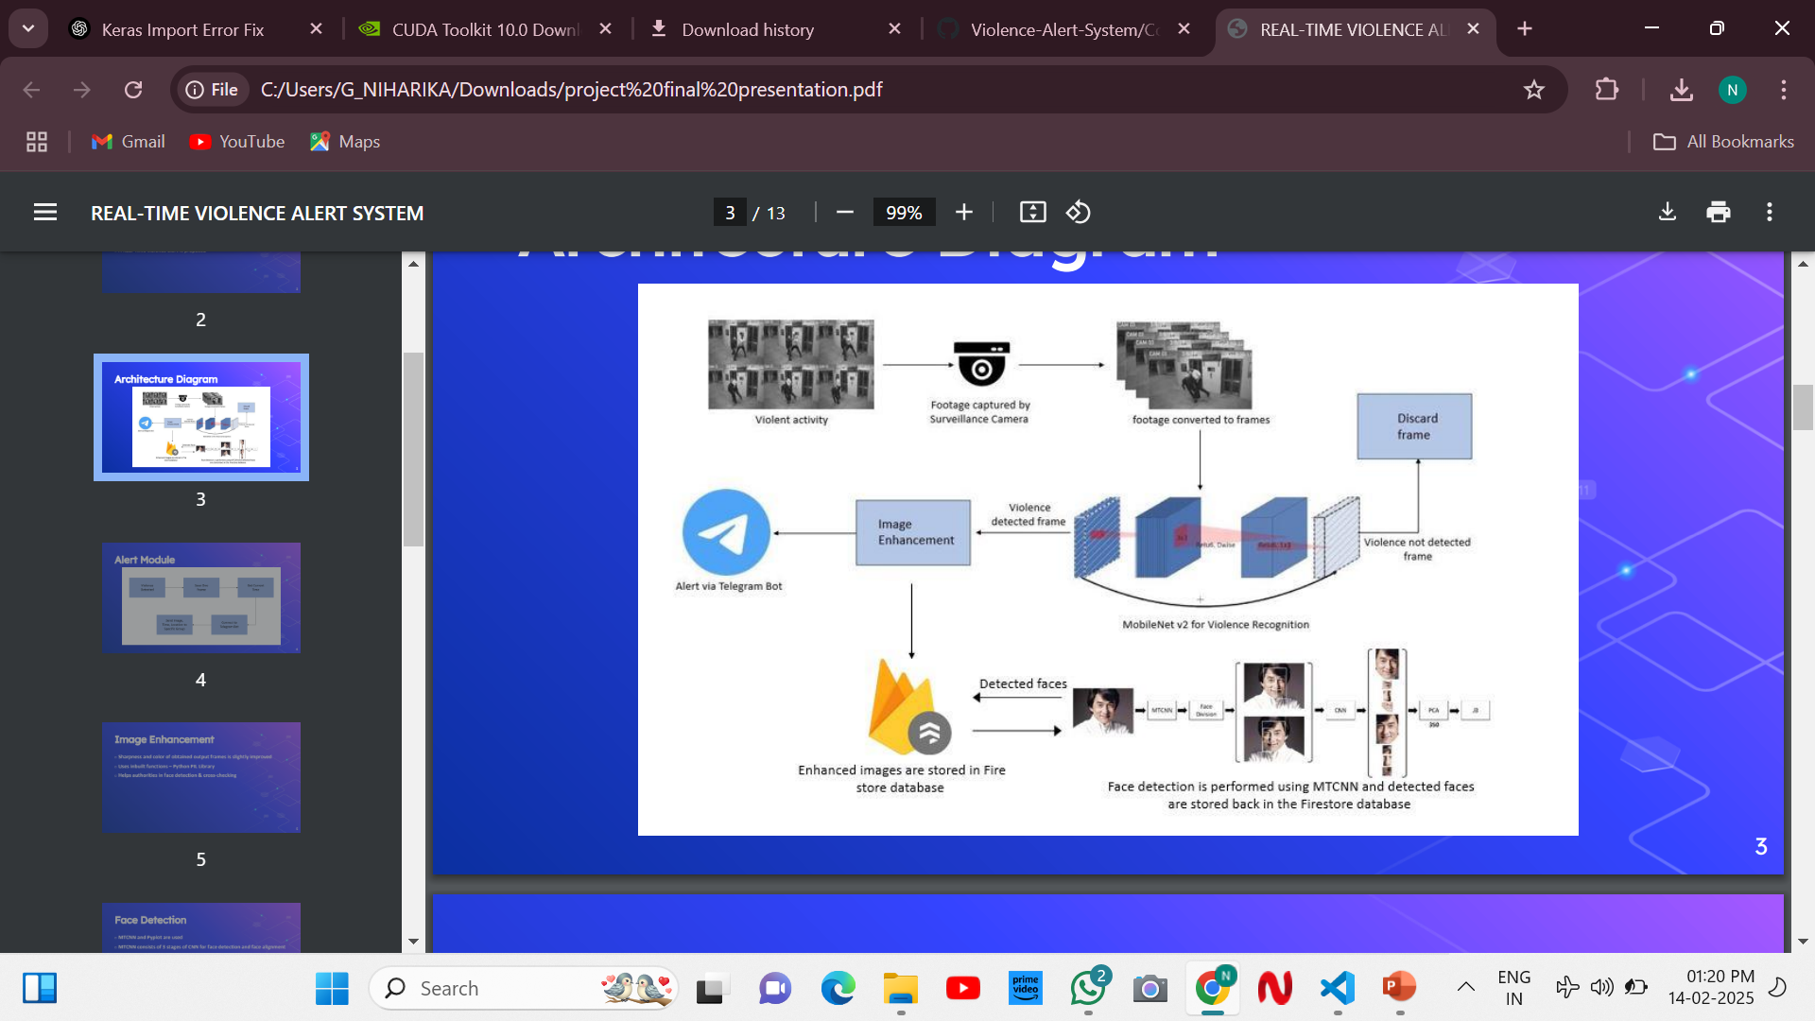
Proposed System Architecture
<< Block Diagram / Flow Chart>>

Slide 8
Module Description
Name of the module | Description of the module
Surveillance & Frame Conversion | Captures footage and converts it into frames.
Violence Detection (MobileNet v2) | Identifies violent activity in frames.
Frame Filtering & Enhancement | Discards non-violent frames and enhances detected ones.
Face Detection & Feature Extraction | Detects faces using MTCNN and extracts features using CNN + PCA.
Firestore Database Storage | Stores enhanced images and detected faces.
Telegram Bot Alert | Sends real-time alerts when violence is detected
Processing & Recognition | Performs image processing and face recognition.

Slide 9
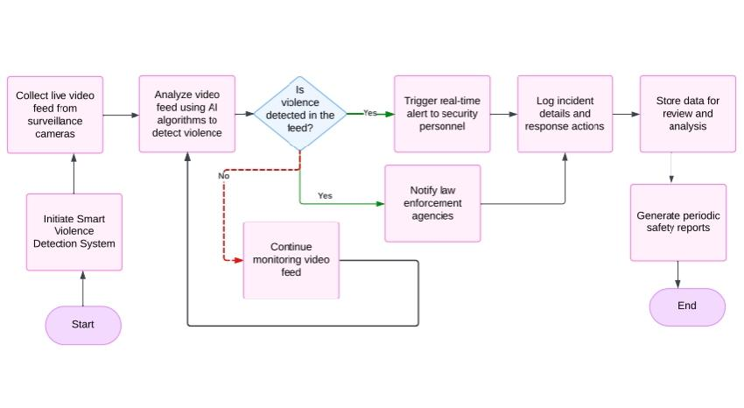
Workflow of the system
<< Block Diagram / Flow Chart>>

Slide 10
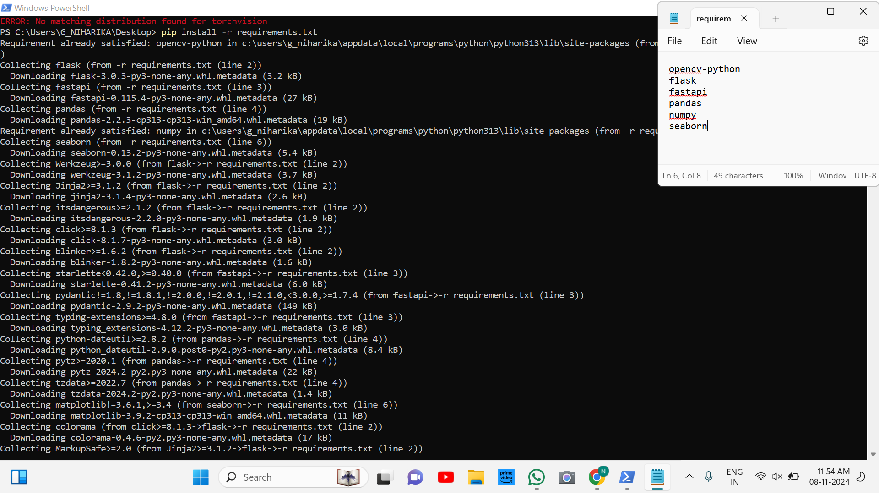
Environmental Setup
<< Screenshots / Photographs >>

Slide 11
Document Structure (make additional copies of this slide based on requirement)
Chapter/Subchapter Sequence Number | Chapter/Subchapter Title
1 | Introduction
1.1 | Project Overview and Objectives
1.2 | Scope of the Project
2 | Literature Review
2.1 | Existing Violence Detection and Alert Systems
3 | System Analysis and Requirements
3.1 | Functional Requirements
3.2 | Non-Functional Requirements

Slide 12
3.3 | Technology Stack
4 | System Design
4.1 | System Architecture
4.2 | Module Design
4.3 | Database Design
5 | Implementation
5.1 | Violence Detection Module
5.2 | Alerting and Notification

Slide 13
5.3 | Web Interface and Database Integration
6 | Testing and Evaluation
6.1 | Test Cases and Results
6.2 | Performance Evaluation
7 | Conclusion and Future Work
7.1 | Summary and Key Findings
7.2 | Future Enhancements
8 | References

Slide 14
IMPLEMENTATION
1. Dataset Preparation
Collected a balanced dataset with 1000 videos each for violence and non-violence.
Extracted every 7th frame from videos for efficient training.
Applied data augmentation techniques such as flipping, zooming, brightness adjustment, and rotation to enhance diversity.
2. Model Training
Fine-tuned a MobileNetV2-based model for binary classification (violence vs. non-violence).
Achieved high accuracy on the validation set.
Saved the trained model as the final detection model for deployment.

Slide 15
3. Backend integration
Developed a Flask API to handle video analysis with the following functionalities:
Accepts video uploads.
Extracts and preprocesses frames from the video.
Runs the detection model on the frames.
Returns a detailed detection report including:
Upload time, detection time, processing duration.
Counts of violent and non-violent frames.
Graphs showing daily violence and non-violence detections.
4. Frontend Implementation
Built a React dashboard with a modern dark-themed UI.
Key features:
Video upload with live preview
Display of detection reports and interactive graphs.
Separate sections for:
Dashboard – Overview of detections.
Alerts & Notifications – Real-time alerts.
Reports & Analytics – Detailed insights.

Slide 16
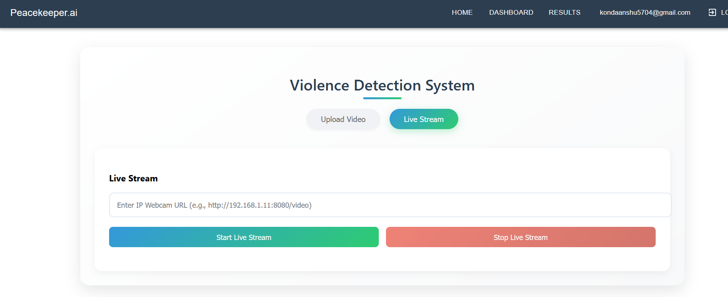
5. Visual Representation
Menu Items:
HOME – redirects to upload page
DASHBOARD – for viewing statistical graphs of detection.
RESULTS – links to past detections in tabular format.).
User Email: Displays currently logged-in user’s email.

Slide 17
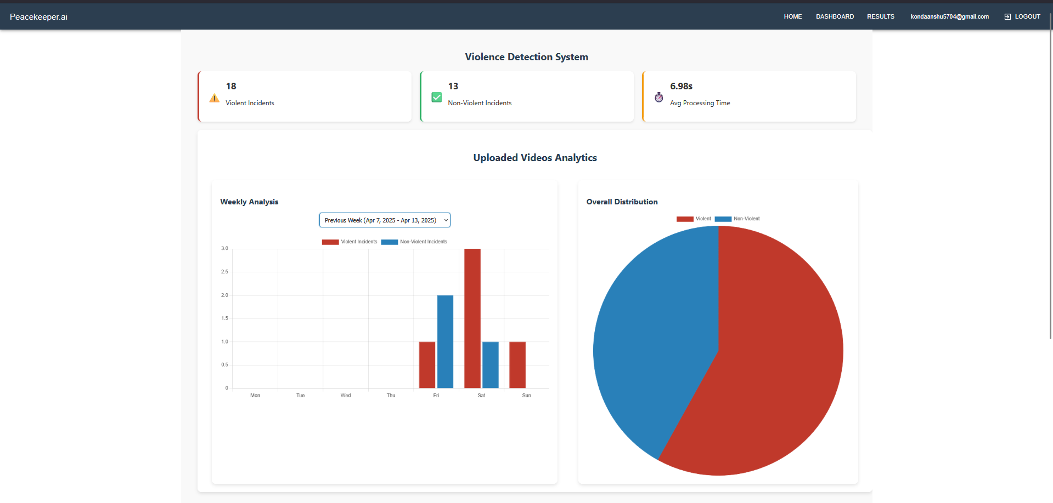
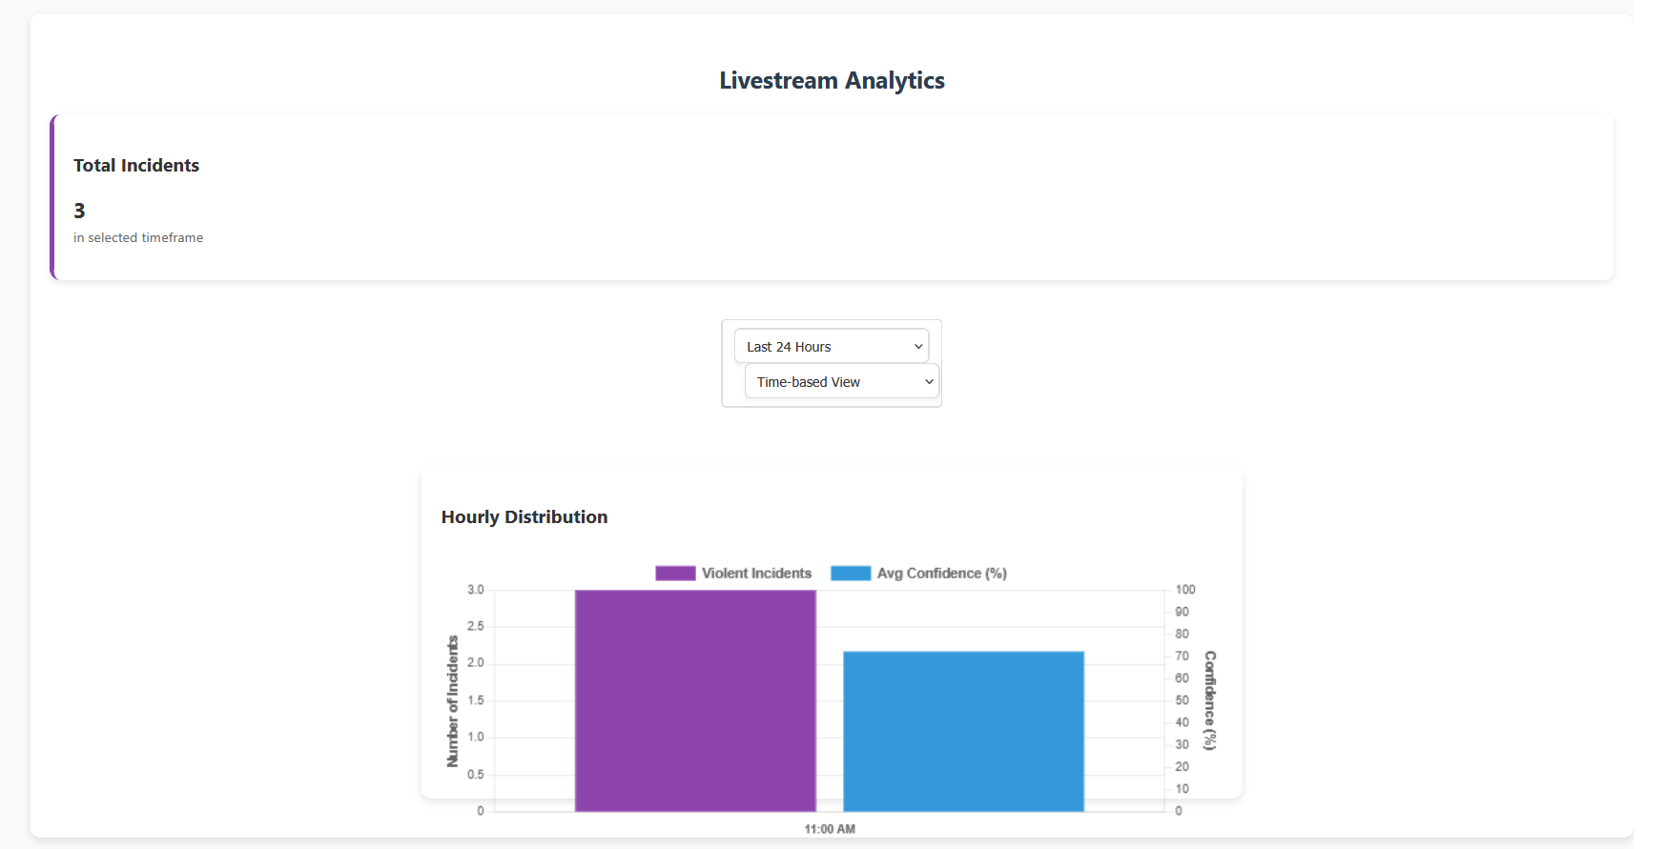
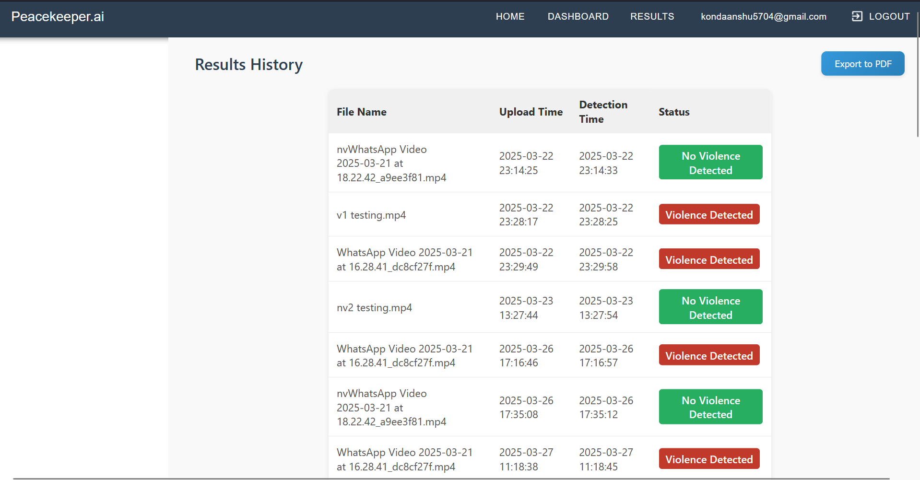

Slide 18
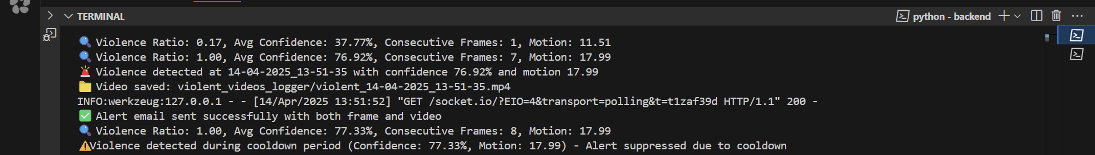
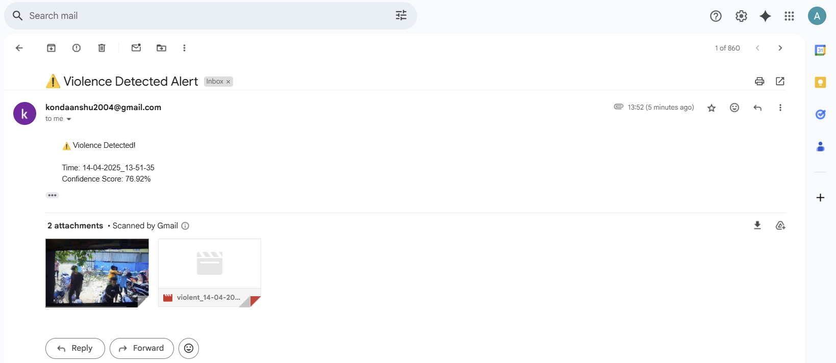
Alerts and Notifications: Upon Violence Detection the alerts are sent to the registered and logged in email of the user

Slide 19
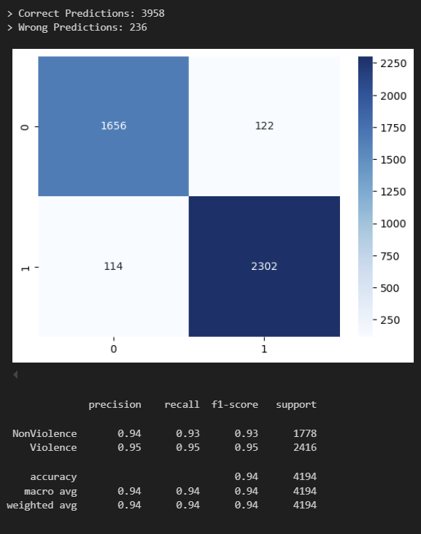
METRICS:

Slide 20

Project Title: Smart Violence Detection with Real-time alerts.
Batch-ID: A-06
Student Team Members:
1.Full Name: BANDI VENKATA SIDDHARTH, Roll No: 2451-21-733-007
2.Full Name : KONDA ANSHU , Roll No: 2451-21-733-011
3.Full Name: G NIHARIKA , Roll No: 2451-21- 733-019
●
Guide: M. MADHURI, Assistant Professor, Dept. of CSE, MVSREC

